Slide 1
Easy DSP Development for TI Heterogeneous Multicore SoCs
Daniel Allred
Texas Instruments

Slide 2
Introduction
Name: Daniel Allred
Title: Senior Applications Engineer
BSEE from University of Florida, MSEE from GeorgiaTech
Four years with Texas Instruments
  Booting and flashing tools
  SoC boot SW considerations including boot-time and runtime security
  C6000 Software Architecture Team
    Heterogeneous Multicore SW Development on TI SoCs
    Including C6000 DSP and specialized accelerators

Slide 3
Agenda
Motivation for DSP+ARM heterogeneous processors
Importance of Software Development
C6000 DSP Ease of Use Initiatives
C6Run Project
  Overview
  C6RunLib
  C6RunApp
Conclusion
Demo
Q&A

Slide 4
Why DSP+ARM?
Lets start with an example system

Slide 5

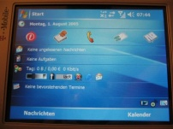
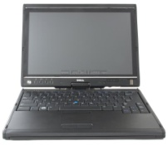
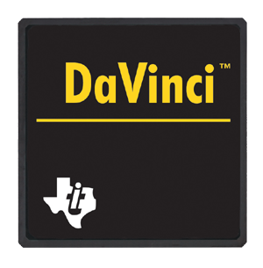
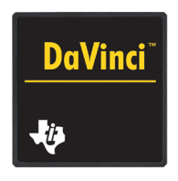


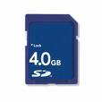
Networked Audio System (before)
Connectivity System
Audio System
HDMI
SPDIF
ADC
LCD
Controller
Internet
Radio
Ethernet
MAC
I2S/
I2C
USB Host
Controller
DAC
ARM9
C674x
Audio DSP
DAC
DAC
SD/MMC
Controller
Problem - Adding connectivity to an audio system adds:
Cost
Components/Size
Development complexity
SDRAM
FLASH
SDRAM
FLASH

Slide 6
Networked Audio System (after)
Buttons/
Knobs
HDMI
SPDIF
ADC
EQEP/
ECAP
LCD
Controller
OMAP-L137
Audio System on a Chip
Internet
Radio
Ethernet
MAC
ARM9
450MHz
Software Link
C674x DSP
450MHz
Serial
Ports
DAC
USB Host
Controller
DAC
DAC
SD/MMC
Controller
I2C/SPI/
UART
PWM
3 Mbit
RAM
8 Mbit
ROM
SDRAM
FLASH

Slide 7

OMAP-L13x Processors
Unmatched Connectivity & Integration for Power-Efficient Processors
The boxes with yellow/red border are not
in all products
ARM9
Subsystem
DSP
Subsystem
Benefits:
PRUSS
ARM
926EJ-S
CPU
C674x DSP
Core
Lower power for longer battery life
  11mW standby & 450mW total power
  Dynamic voltage & frequency scaling
  Large on chip memory, fewer external accesses
  Mobile DDR support
Algorithm precision
  32-bit and 64-bit precision floating-point
  Extended precision fixed-point
Software Reuse
  Code compatibility with previous C6000 devices
  Scalability between pin-compatible ARM-, DSP-only and ARM+DSP parts
Additional control and protocol expansion through PRU subsystem
LCD
Controller
L1P 18K
L1D 18K
L1P 32K
L1D 32K
L2 256K
uPP
(L1x8 Only)
Video I/O
(L1x8 Only)
128KB
RAM
Switched Central Resource (SCR) / EDMA
Peripherals
Connectivity
System
USB2.0
HS
USB 1.1
SATA
(L1x8 Only)
WD
Timer
PWM
eCAP
eQEP
UHPI
EMAC
Serial Interfaces
Program/Data Storage
I²C
UART
mDDR/
DDR2/
SDRAM
16-bit
Async
EMIF
16-bit
MMC/
SD
SPI
McASP
McBSP

Slide 8
What can a system developer do with the DSP
Run math intensive algorithms
Leverage some DSP features, like floating-point computations
Free up ARM MIPS for additional system features
Save money by not moving to a more powerful & expensive ARM!
Get true real-time response via DSP without sacrificing features of a high-level OS like Linux

Slide 9
Agenda
Motivation for DSP+ARM heterogeneous processors
Importance of Software Development
C6000 DSP Ease of Use Initiatives
C6Run Project
  Overview
  C6RunLib
  C6RunApp
Conclusion
Demo
Q&A

Slide 10
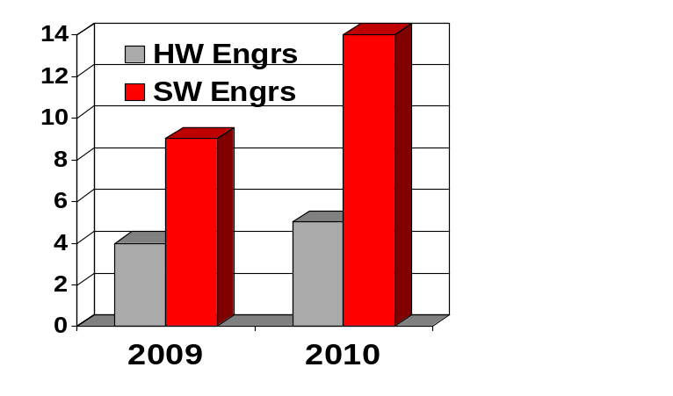

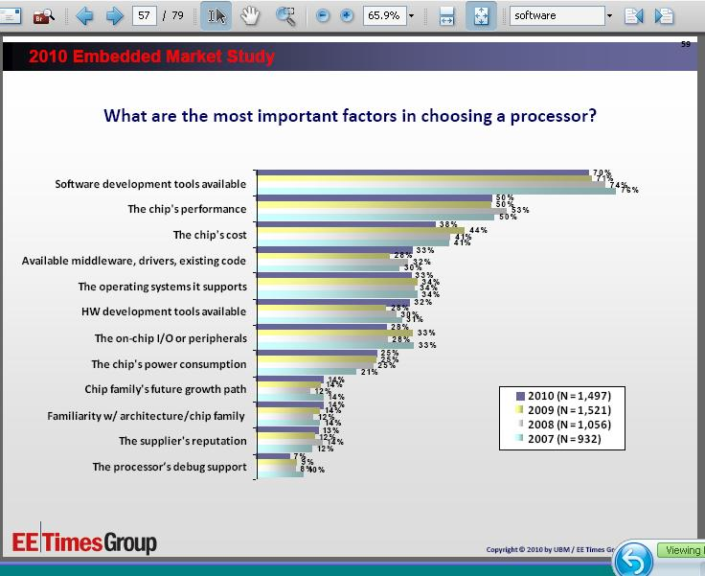


Importance of software in embedded development
14
Companies are dedicating more resources to software
Average embedded
team size
9
5
4
Purchase decisions are driven by software
Most important
embedded processor
selection criteria
Source: US EE Times/ESD annual embedded developer survey (Jan/Feb ‘10)

Slide 11
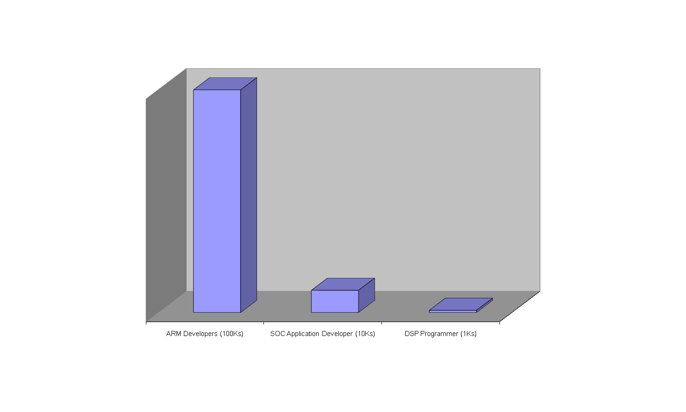
Changing face of TI DSP developers
DSP+ARM devices provide an opportunity for TI and our customers
Example: Beagleboard
  Greater than 10000 sold, each one containing a C64x+ DSP
  How do we connect with those developers?

Slide 12
Agenda
Motivation for DSP+ARM heterogeneous processors
Importance of Software Development
C6000 DSP Ease of Use Initiatives
C6Run Project
  Overview
  C6RunLib
  C6RunApp
Conclusion
Demo
Q&A

Slide 13
Weapons of Code Construction
SOC (DM) Programmers using DVSDK
C6ACCEL
C6000 DSP Customers
ARM Linux Programmers
C6RUN
C6FLO
Users of more basic DSPs

Slide 14
Universe of embedded developers – leveraging the DSP
Embedded Developers | Customer Needs
DSP developer | Faster prototyping
System developer | More ready-to-use DSP functionality with audio, video and voice codecs
ARM® developer | Leverage the DSP without specialized knowledge
Tool
C6Flo
C6Accel \
C6Run

Slide 15
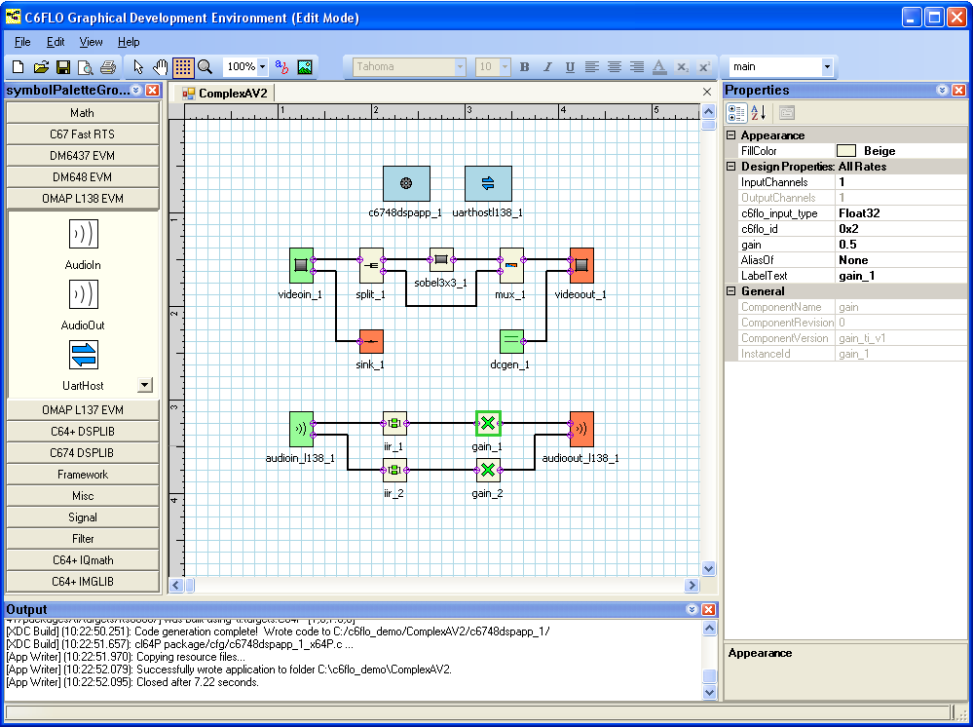
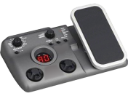

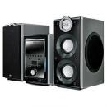
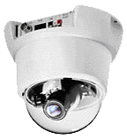
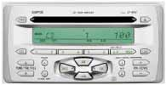
C6Flo: DSP prototyping in minutes!
Properties Pane
Block Palette
System Block Diagram
Output Window

Slide 16


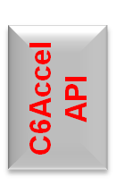



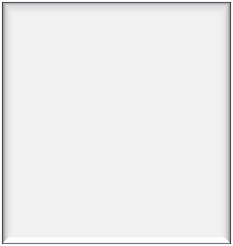




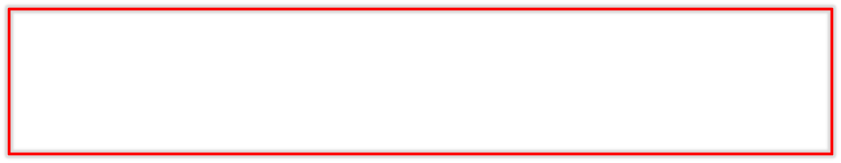
Experience with C6Accel!
Codec Engine
C6Accel
DSPLIB IMGLIB
MATHLIB
Audio, Video Codecs
ARM® processor
DSP
hC6accel = C6accel_create( engName, NULL, algName, NULL);
………………..
Status = C6accel_DSPfunction(hC6accel, parameters);
……………………
C6accel_delete(hC6accel);
Above converts C code creates a C6Accel handle with the codec server
Passes function ID for DSP kernel, manages cache and contiguous memory required to pass input parameters, makes iUniversal process call to the codec engine and returns error status.
Closes the C6Accel instance

Slide 17
Agenda
Motivation for DSP+ARM heterogeneous processors
Importance of Software Development
C6000 DSP Ease of Use Initiatives
C6Run Project
  Overview
  C6RunLib
  C6RunApp
Conclusion
Demo
Q&A

Slide 18
C6Run Overview
Open Source Project, hosted on gforge.ti.com
Intends to provide an abstracted mechanism for getting code running on the DSP
Project Goals
  Introduce DSP Development to ARM/Linux developer
  Simplify simple application/function offloading to the DSP
  Start getting Linux and open-source community using the DSP

Slide 19
Project Details
Currently consists of several components:
  Common back-end libraries
  C6RunLib front-end build tools
  C6RunApp front-end build tool
C6RunLib: Partition an application between the ARM and DSP
C6RunApp: Run an entire application on the DSP

Slide 20
C6RunLib
Goal is to automate building an ARM-side library from user’s C code of critical functions
User can call into that library in their app, and calls will be executed on the DSP
Consists of automating creation of RPC framework, hiding DSPLink and other TI specific bits as possible
ARM
DSP
Extract Critical Fxns as a library using C6RunLib
ARM Application
C6RunLib Framework
Stub Library
Critical
Fxns

Slide 21
ARM-only Development
module1.c
module2.c
main.c
critical.c
GCC Toolchain
ARM Executable
ARM+DSP Development with c6runlib
module1.c
ARM Executable
module2.c
main.c
GCC Toolchain
Embedded DSP Executable
critical.c
c6runlib tools
critcal.lib

Slide 22
Example C6RunLib Usage
$ c6runlib-cc -c -O2 –o dummy.o dummy.c
Above converts C code containing critical functions to C6000 object file
Also analyzes global C functions and generates ARM-side remote procedure call stubs
$ c6runlib-ar rcs dummy_dsp.lib dummy.o
Add object file to library dummy_dsp.lib
Underneath, the dummy.o object file is linked to a DSP executable and compiled into the framework
Framework object file and stubs object file is archived into the lib
ARM-side stubs resolve symbols for ARM application when built against the library

Slide 23
C6RunApp
Consists of two parts
  Backend library builds
  Front end user interface
Backend libraries collate DSPLink, CMEM, DSP/BIOS, and custom code
Front end interface is a command-line cross compiler script (acts like GCC)
Entire application retargets to DSP, but with C I/O access to ARM/Linux
Ready now (support for OMAPL1, OMAP3, including hawkboard, beagleboard)
ARM
DSP
C6RunApp Framework
Recompile using C6RunApp
DSP Loader and CIO Server
C Application

Slide 24
ARM-only Development
module1.c
module2.c
main.c
GCC Toolchain
ARM Executable
DSP Development using c6runapp
module1.c
module2.c
ARM Executable
main.c
c6runapp tool
Embedded DSP Executable

Slide 25
Example C6RunApp Usage
$ c6runapp-cc -o hello_world hello_world.c
Compiles hello_world.c to C6000 object file, which is then linked into a DSP executable
Executable is compiled into the ARM side framework, which is used to build an ARM-side executable called hello_world
Notes on the c6runapp-cc cross-compiler tool:
  Front end script wraps the TI C6000 Codegen tools (specifically cl6x)
  Supports many GCC options and translates them to appropriate cl6x options
  Many GCC optimization/warning options are silently ignored
  Unknown options passed directly to cl6x command-line

Slide 26
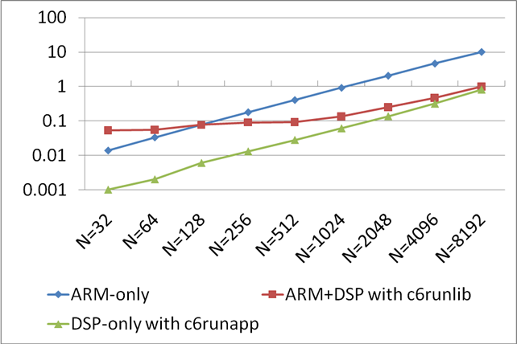
Complex FFT Performance
Total Execution Time (s) For 100 FFT Iterations
FFT runs ~10x faster on DSP than on ARM.
Small FFT size, overhead dominates, running on DSP does not provide advantage.
Larger FFT size, overhead absorbed, running on DSP provides advantage.
FFT Size
SoC: ARM9 + Floating-Point DSP
CPU Frequency: 300MHz
Code & Data Location: External DDR2 Memory
Instruction and Data Cache: Enabled
Single-precision floating-point data buffers.

Slide 27
Agenda
Introduction and Problem Statement
Motivation for DSP+ARM heterogeneous processors
Current TI software technologies
  Codec Engine, DSPLink, CMEM, etc.
C6Run Project
  Overview
  C6RunLib
  C6RunApp
Conclusion
Demo
Q&A

Slide 28
Status and Availability
Documentation available on TI’s Embedded Processor Wiki
  http://processors.wiki.ti.com/index.php/C6Run_Project
Latest package is available at TI’s website
  http://focus.ti.com/docs/toolsw/folders/print/c6run-dsparmtool.html
  Public GForge/SVN project: https://gforge.ti.com/gf/project/dspeasy/
Features/limitations
  Standard C library support, no POSIX API support
  DSP is wholly owned by single ARM application (no sharing with CE or other frameworks)
  C6RunLib: Supports only synchronous function dispatch, only one function call in flight at a time
  C6RunLib: Function support may be limited (fxn arguments must be native C types, or pointers to native C types – no structs, unions, variable length arguments, etc.)

Slide 29
Conclusion
TI believes DSP+ARM devices offer our customers an advantage in system integration and design
TI is committed to helping our customers leverage the power of the DSP by offering easy to use software development solutions
C6Run is a quick way for the ARM developer to gain access the capabilities of the DSP using the ARM/Linux operating system

Slide 30
Demo
Installing C6Run tool
Building Code with C6Run
Questions

